Slide 1

Big Data

Slide 2
What is Big Data?
“extremely large data sets that may be analyzed computationally to reveal patterns, trends, and associations, especially relating to human behavior and interactions.”
Most of the time, you will not encounter this. Most organizations don’t have big data.
However, you may see it, so here’s how to deal with it.

Slide 3
Step 1 – run complex jobs during “down time”
You have a query, report, job that takes a while, slowing the whole system.
Could you run it at 2AM, when (almost) no one is working?
Pros: FREE, easy, solves the problem(?)
Cons: 2AM support calls (or dealing with fallout if the job fails), assumes a window of “down time”

Slide 4
Step 2 – bump up the hardware
Is your SQL Server somebody’s old desktop that got repurposed?
Hardware is cheap today – a few thousand will get you a decent (used) server. For “business critical” data, that’s a good deal.
SSD is a HUGE performance gain on most job mixes.
Pros: Easy, relatively cheap, improves life for the future
Cons: Costs money, migration time/project

Slide 5
Step 3 - Replication
Get a second set of hardware and set up replication.
Run read only queries (reports) against the replicated data.
BE CAREFUL – replication may not always transfer complete sets of data – the cut off is arbitrary. So your replicated database may be SLIGHTLY out of date. This can be a problem if, say, you don’t wrap your transactions appropriately.
Pros: You now have replication and better “uptime”
Cons: Cost, project to set up, complex queries may slow replication processes.

Slide 6
Step 4: Data Warehouse
At this point, we have good hardware, replicated and we still can’t support the query needs of the business.
Our solution is to create a whole different database on different hardware. The business users will query that data warehouse instead of our “live” system for most of their query needs.

Slide 7
How is this different from replication?
Replication intends to make an exact copy of the database and to keep it in sync “real time”.
A data warehouse doesn’t have to be an exact copy of the database – it just needs to have the data that the business users need.
For example – we might be doing application logging to the database, storing user account info and tracking cancelled appointments. The business users probably don’t care about that.

Slide 8
This sounds like a whole new design!
It is! A well done data warehouse starts back at requirements gathering. Finding out what kinds of data the business users want/need, specifying hardware, etc.
One interesting tidbit – your data warehouse database design might look radically different from your database design!
In fact, while our OLTP database should be normalized, this database will probably NOT be!

Slide 9
Denormalized? Are you serious?
Yes! This is a read only database. Repeating data will make queries faster.
Take for example: patient – diagnosis – diseaseName. That’s 3 joins to find out that a patient has Hepatitis C. For massive amounts of data, that’s painful. What if we included diseaseName in a new diagnosisDisease table? We would reduce the joins by ½!

Slide 10
How will be do this?
This sounds like a lot of work. I would have to write a bunch of stored procedures or something to run the queries to extract, transform and load the data.
This process, called “ETL” is a common problem and there exists solutions for this very problem.

Slide 11
SQL Server Integration Services
SSIS is a tool designed for ETL. It allows you to create complex control flows with event driven logic. It is an interesting flowchart driven language that advanced business users can use.
SSIS makes “packages” – you can think of them as application – which can be run by SQL Agent.
Unfortunately, it is not available in the Express edition.

Slide 12
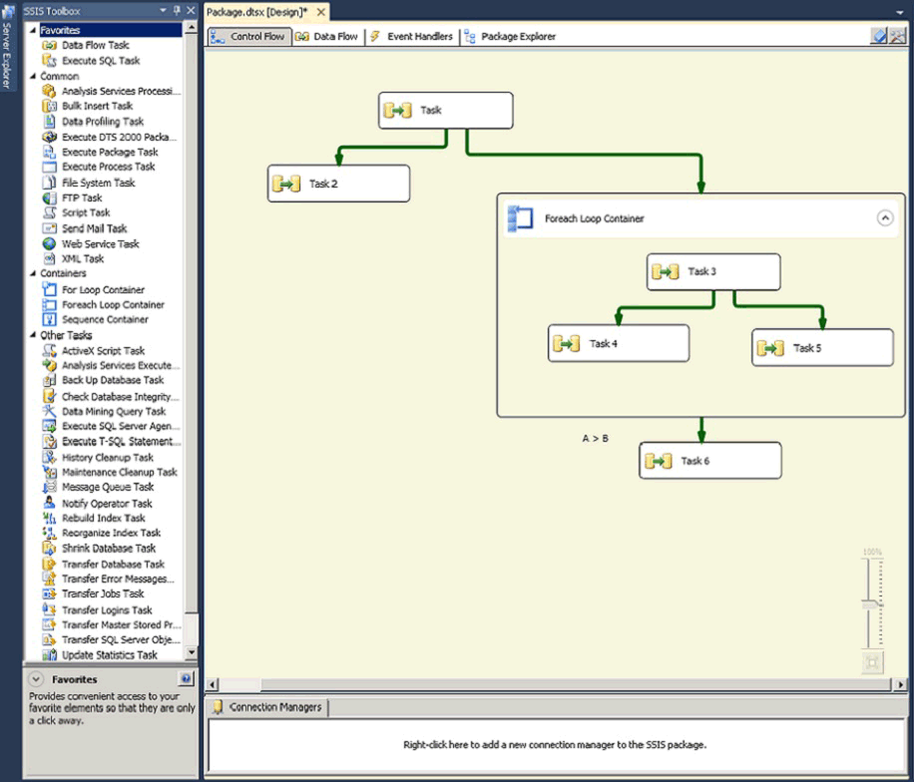
SSIS Designer

Slide 13
SQL Server Analysis Services
Data mining is a hot topic, but it is not new to SQL Server – SSAS has been part of the SQL Server family since the early 2000’s.
Vocabulary: OLTP – online transaction processing (“what we normally do”)
OLAP – online analytical processing (“what business analysts need”)

Slide 14
Business Intelligence
The idea behind business intelligence is finding answers to questions about your business that will help to guide the business to greater profitability/efficiency.
In our hospital example, we might ask questions like: How many procedures were done last year?
How effectively did we bill insurance companies in Q1 and how has that changed over the last 5 years?
Which diseases are trending up in Hispanic patients over 50?

Slide 15
Change the schema
The first step is to radically change our schema (remember this is a read-only copy). We no longer worry about repetition, safety or other good table design practices – only the things that we actually care about for these queries.
We try to arrange our data into a star shaped schema with the basic element of our business in the middle. In a store, it is a sold item. In the hospital, likewise, it is a treatment.

Slide 16
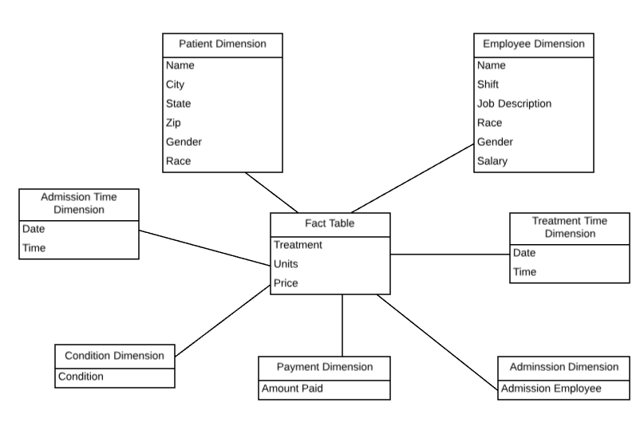

Slide 17
Comments on the star schema
Clearly, this is pretty easy to query. We reduced a lot of the normalization, removed some data that we don’t care about and condensed our data into a fairly small schema. This is typical for OLAP.
But, we really don’t have the ability to ask some of those interesting questions yet. Our data is still very granular. We can still tell that “John Smith” had shingles on June 7. What we really want is to aggregate this data so that we can see big picture trends.
Right now, we can’t see the forest because all the trees are in the way!

Slide 18
Data Cubes
Data cubes are not really cubes (sides same size, 3 dimensions), but that’s what they are called.
A cube is a data structure that holds the aggregated data in a multidimensional matrix. It then becomes easy to query “the cube” for trends because the matrix holds the rolled up data – we can “slice” the data lots of different ways.

Slide 19
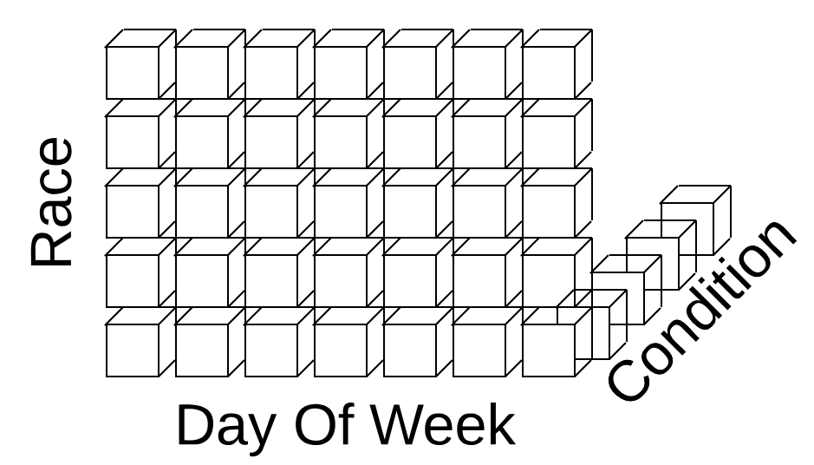
Our sample cube
Consider a cube with 3 dimensions: patient race, day of week of admission, condition.

Slide 20
Our Sample Cube
Assume that each box contains the count of people of that race with that condition (COUNT()), the amount charged (SUM()) and the amount paid (SUM()).
Now, if I want to ask which day of the week white people have headaches the most, it is an easy query. Or which race has more broken legs on weekends.

Slide 21
A little more SQL…
In your data warehouse, you may find that some very wide and tall tables are very slow for many queries.
Recall that tables are stored by row:
row 1: your data here..
row 2: your data here…
And indices are stored by value(s) and page:
value 1: page 17, 253, 8972
value2: page 425, 823,6839

Slide 22
Row storage
Imagine if we want to query the person table to find how many women are over 50. Even if we have indices on both of those criteria, we still need to read all of the pages.
This makes a lot of sense for OLTP – most of the time, we need to consider a whole row – an insert, a delete, etc.
But for OLAP, we probably only care about a few columns, but about all of the data for those few columns. Maybe rows aren’t the right division of the data for OLAP…

Slide 23
Column oriented storage
Imagine if the patient data were specified like this:
Gender Age:
1: F 1: 43
2: M 2: 74
3: M 3: 32
4: F 4: 79
5: F 5: 92
… …
How many (relatively) values that we care about could we fit in a page?
How hard would it be to compute the women over 50?
How would SELECT * WHERE… work?

Slide 24
But wait, there’s more!
You noticed that there was a lot of repetition. Genders and ages tend to be pretty similar. Similar data compresses really well.
Column storage is compressed in SQL Server. This means that we can fit even MORE data elements in a single column. SQL Server may use a dictionary for this compression (essentially LZH); this is a big savings for strings…
Perhaps the best part, though, is that these are “just” indices. You can keep the original row based table and have these column storage indices.

Slide 25
How can I create one of these?
CREATE NONCLUSTERED COLUMNSTORE INDEX myindexName ON
tablename (column1, column2, …, column N)
Just like a “typical” index, except with the key work “COLUMNSTORE”.

Slide 26
Big Data Roundup
As SQL professionals, we have “the keys to the kingdom” – access to all of the organization’s data.
The organization depends on us to make that data available to them in ways that allow them to do the work that they need to do.
Our DBMS supports us with a variety of tools (vendor specific).
We can throw out the rules if we make a data warehouse to support our users, but there is a significant time/finance cost.

